Slide 1
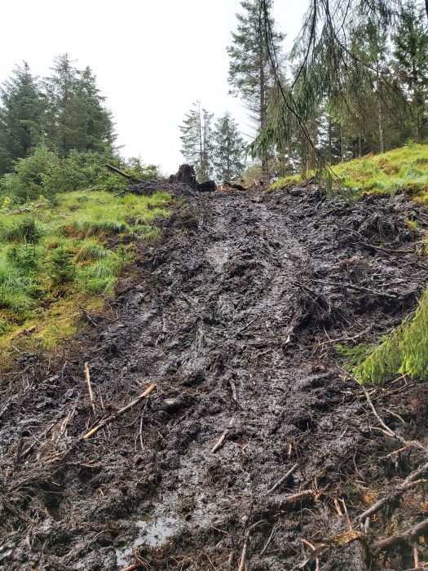
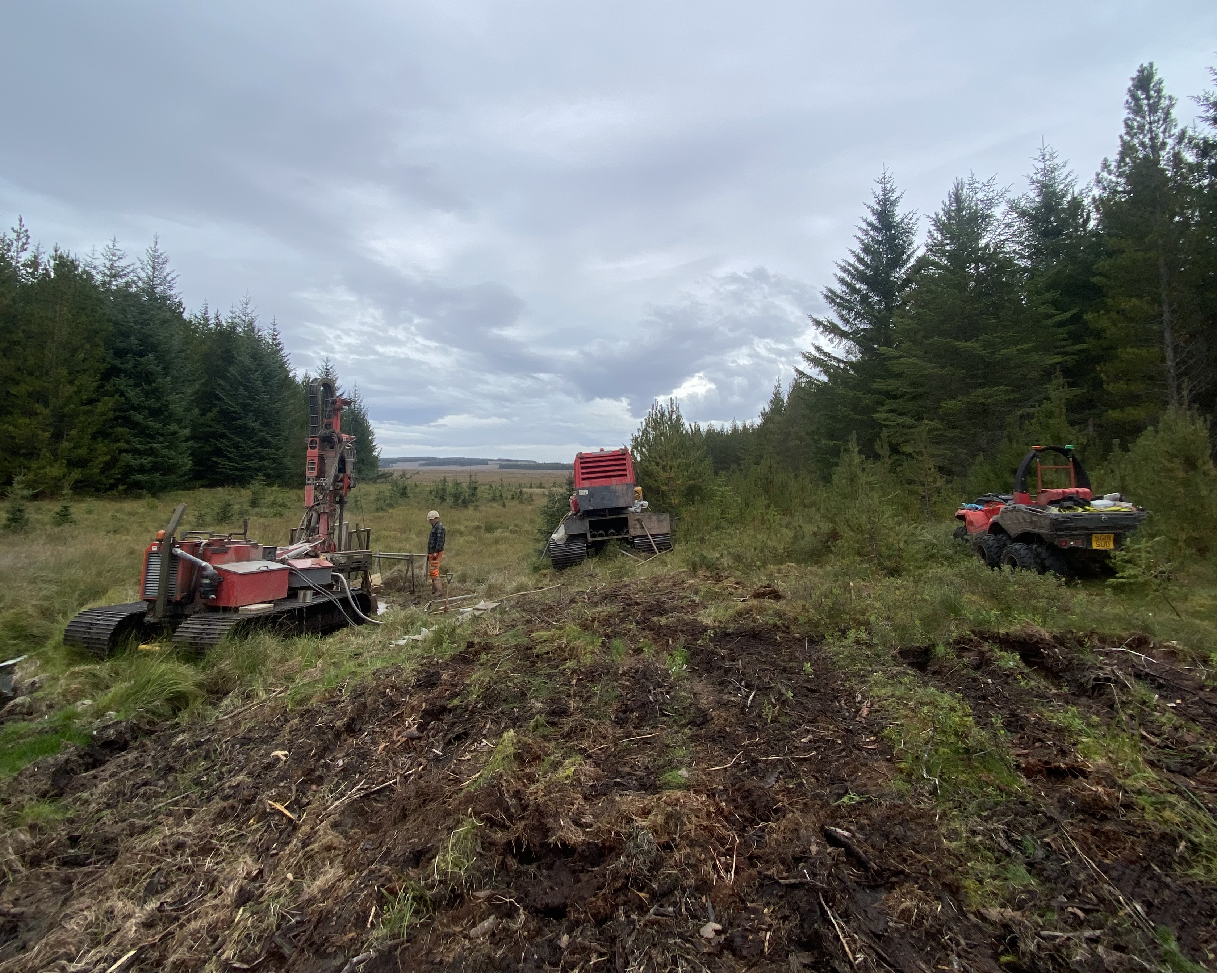
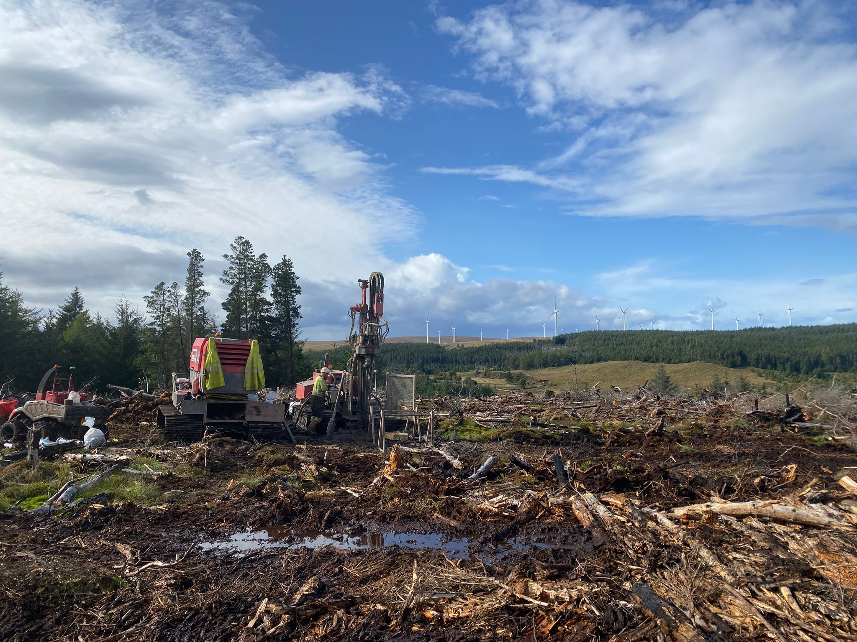
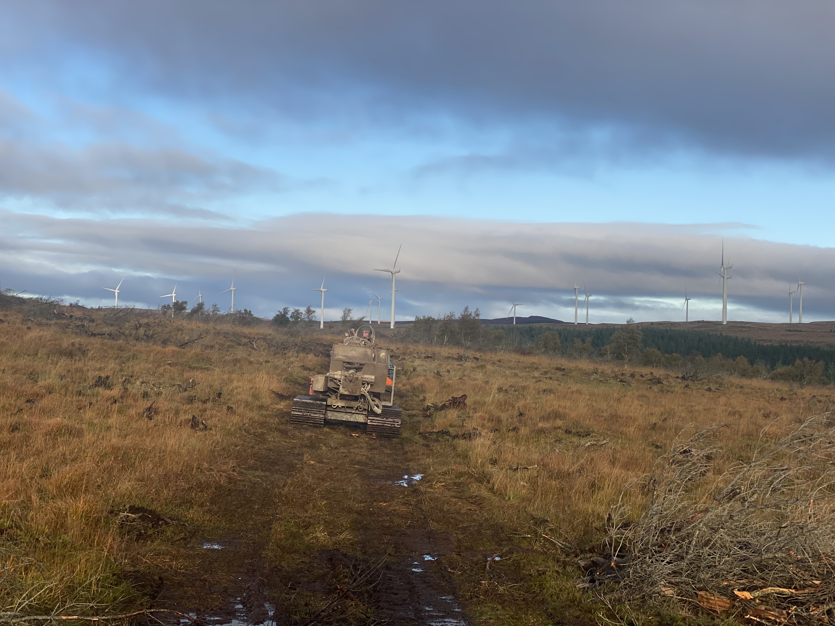
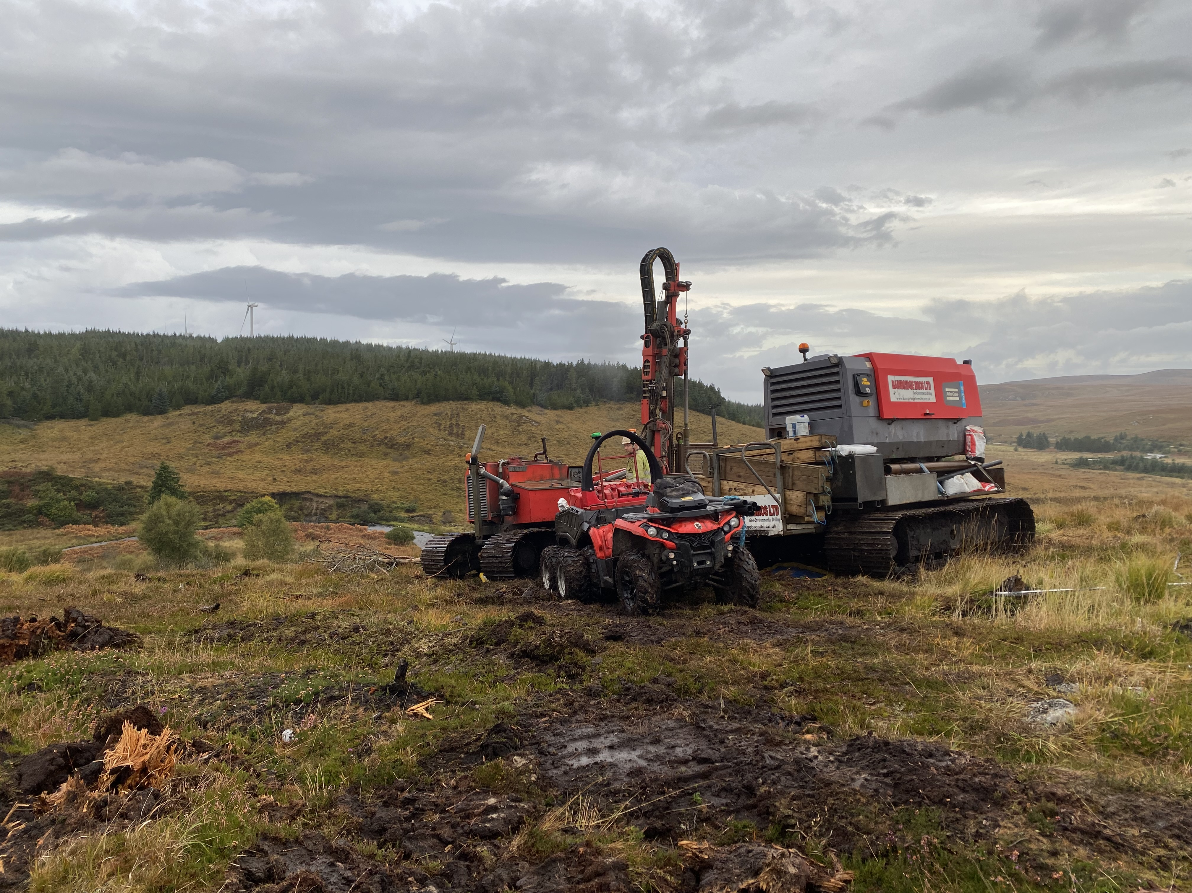
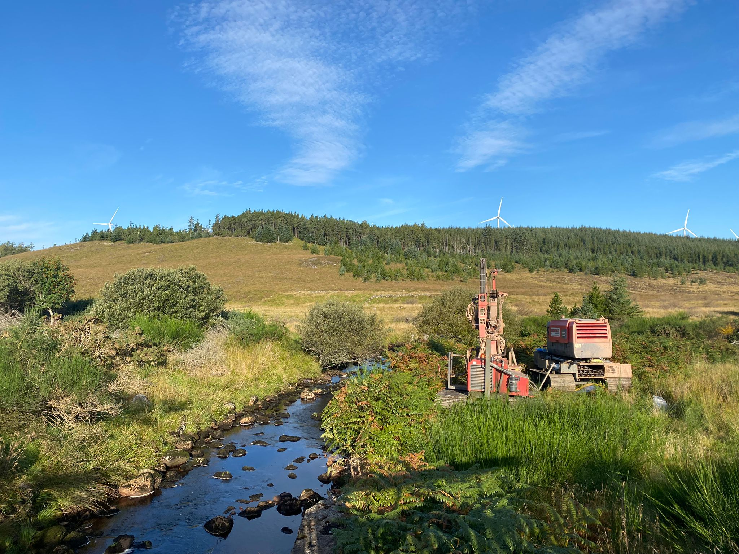
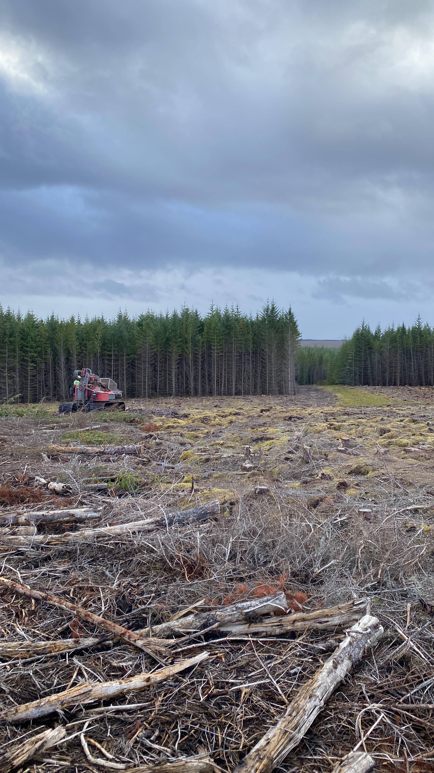
Case Study: Strathy Wood and Strathy Wood South Wind Farm
To facilitate the recent advancement in renewable energy generation across Scotland, two new proposed windfarms are to be constructed to the south of the existing Strathy North Windfarm (Strathy Wood (RWE) and Strathy South (Scottish and Southern Energy).
Bainbridge Brothers Limited (BBL) were appointed by The Land Consultancy (TLC) on behalf of their end clients RWE AG and SSEN to complete the the entire drilling aspect of Strathy Wood and at the location of a number of temporary bridges on Strathy South. In total 27 boreholes were undertaken across the two projects in the locations of proposed turbines, either temporary or permanent bridges, a substation and potential borrow pit locations. The boreholes were drilled using initially Geobor-S techniques within the superficial deposits switching to air mist rotary coring within the bedrock. Groundwater monitoring standpipes were also installed within most borehole locations.
The majority of the borehole locations were situated on felled forest, undertaken by RWE subcontractors, with ‘brash mats’ installed to form access to the borehole locations. Therefore, an ultra-widespread drilling rig with an accompanying support tracked compressor unit was utilised to traverse the terrain. A Canam 6x6 All Terrain Vehicle (ATV) was used to carry supplies to the borehole location to avoid moving the plant more than necessary.
More information on the projects can be found at:
https://uk.rwe.com/project-proposals/strathy-wood/
https://www.sserenewables.com/onshore-wind/in-development/strathy-south/

