Slide 1
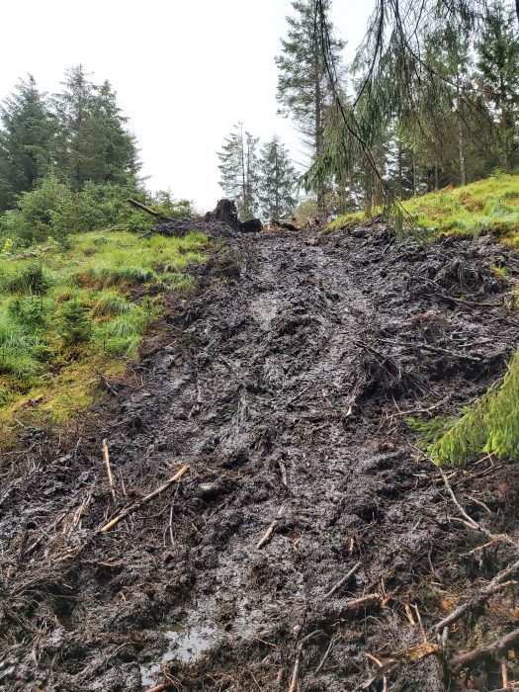
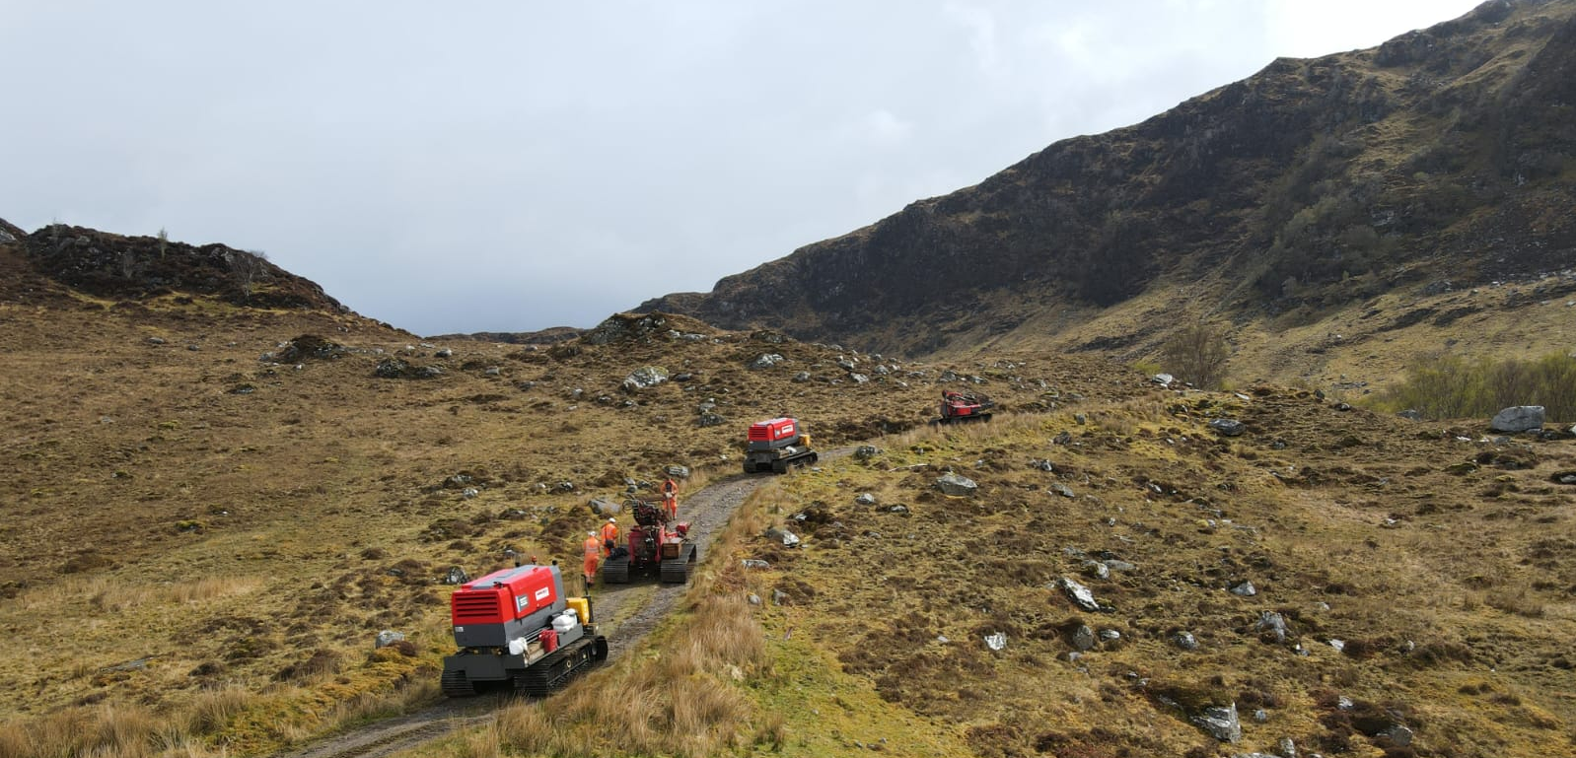
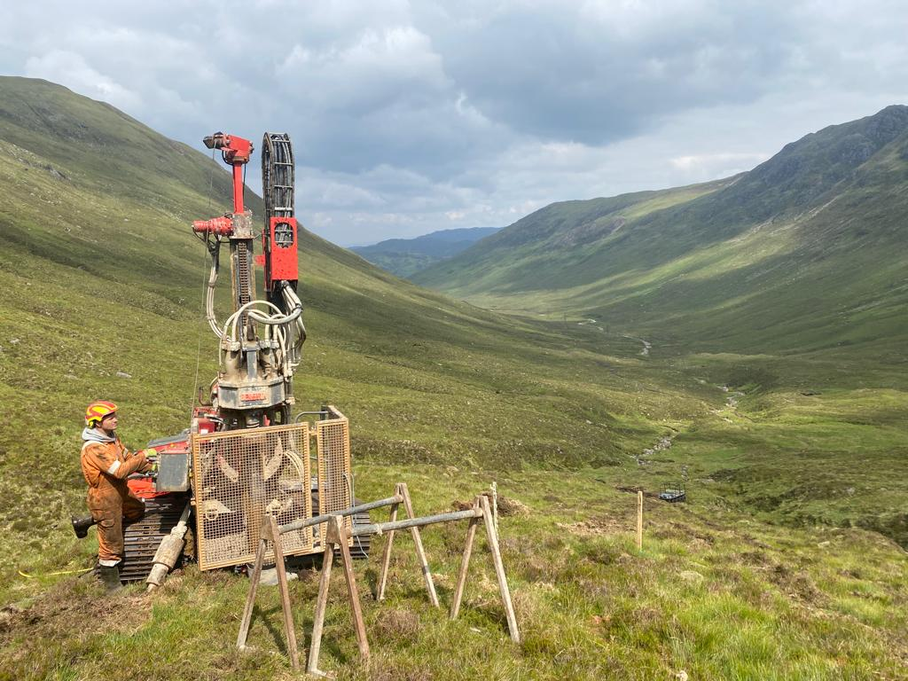
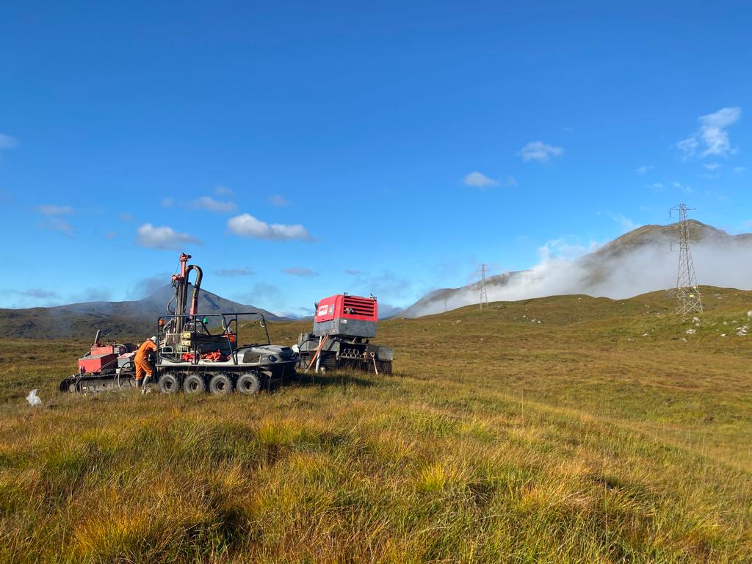
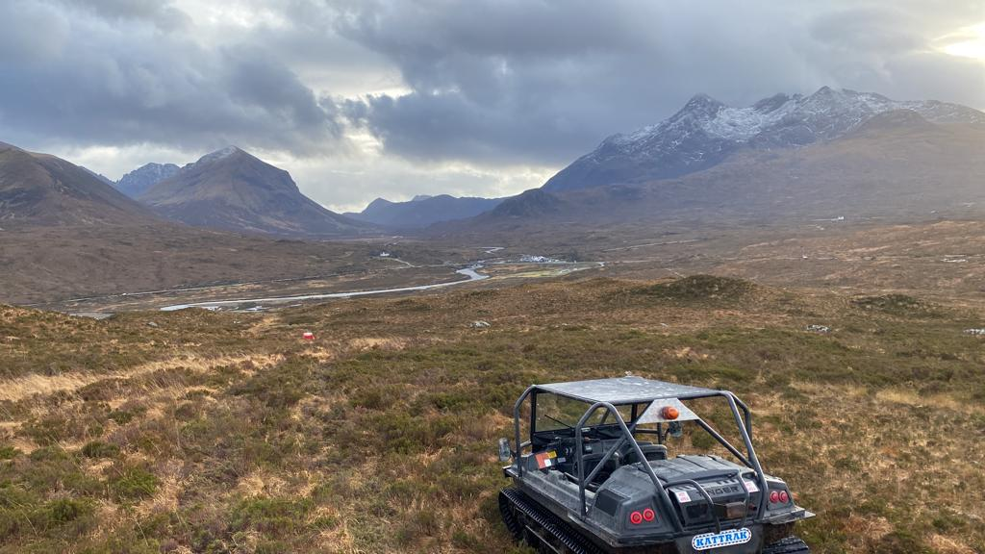
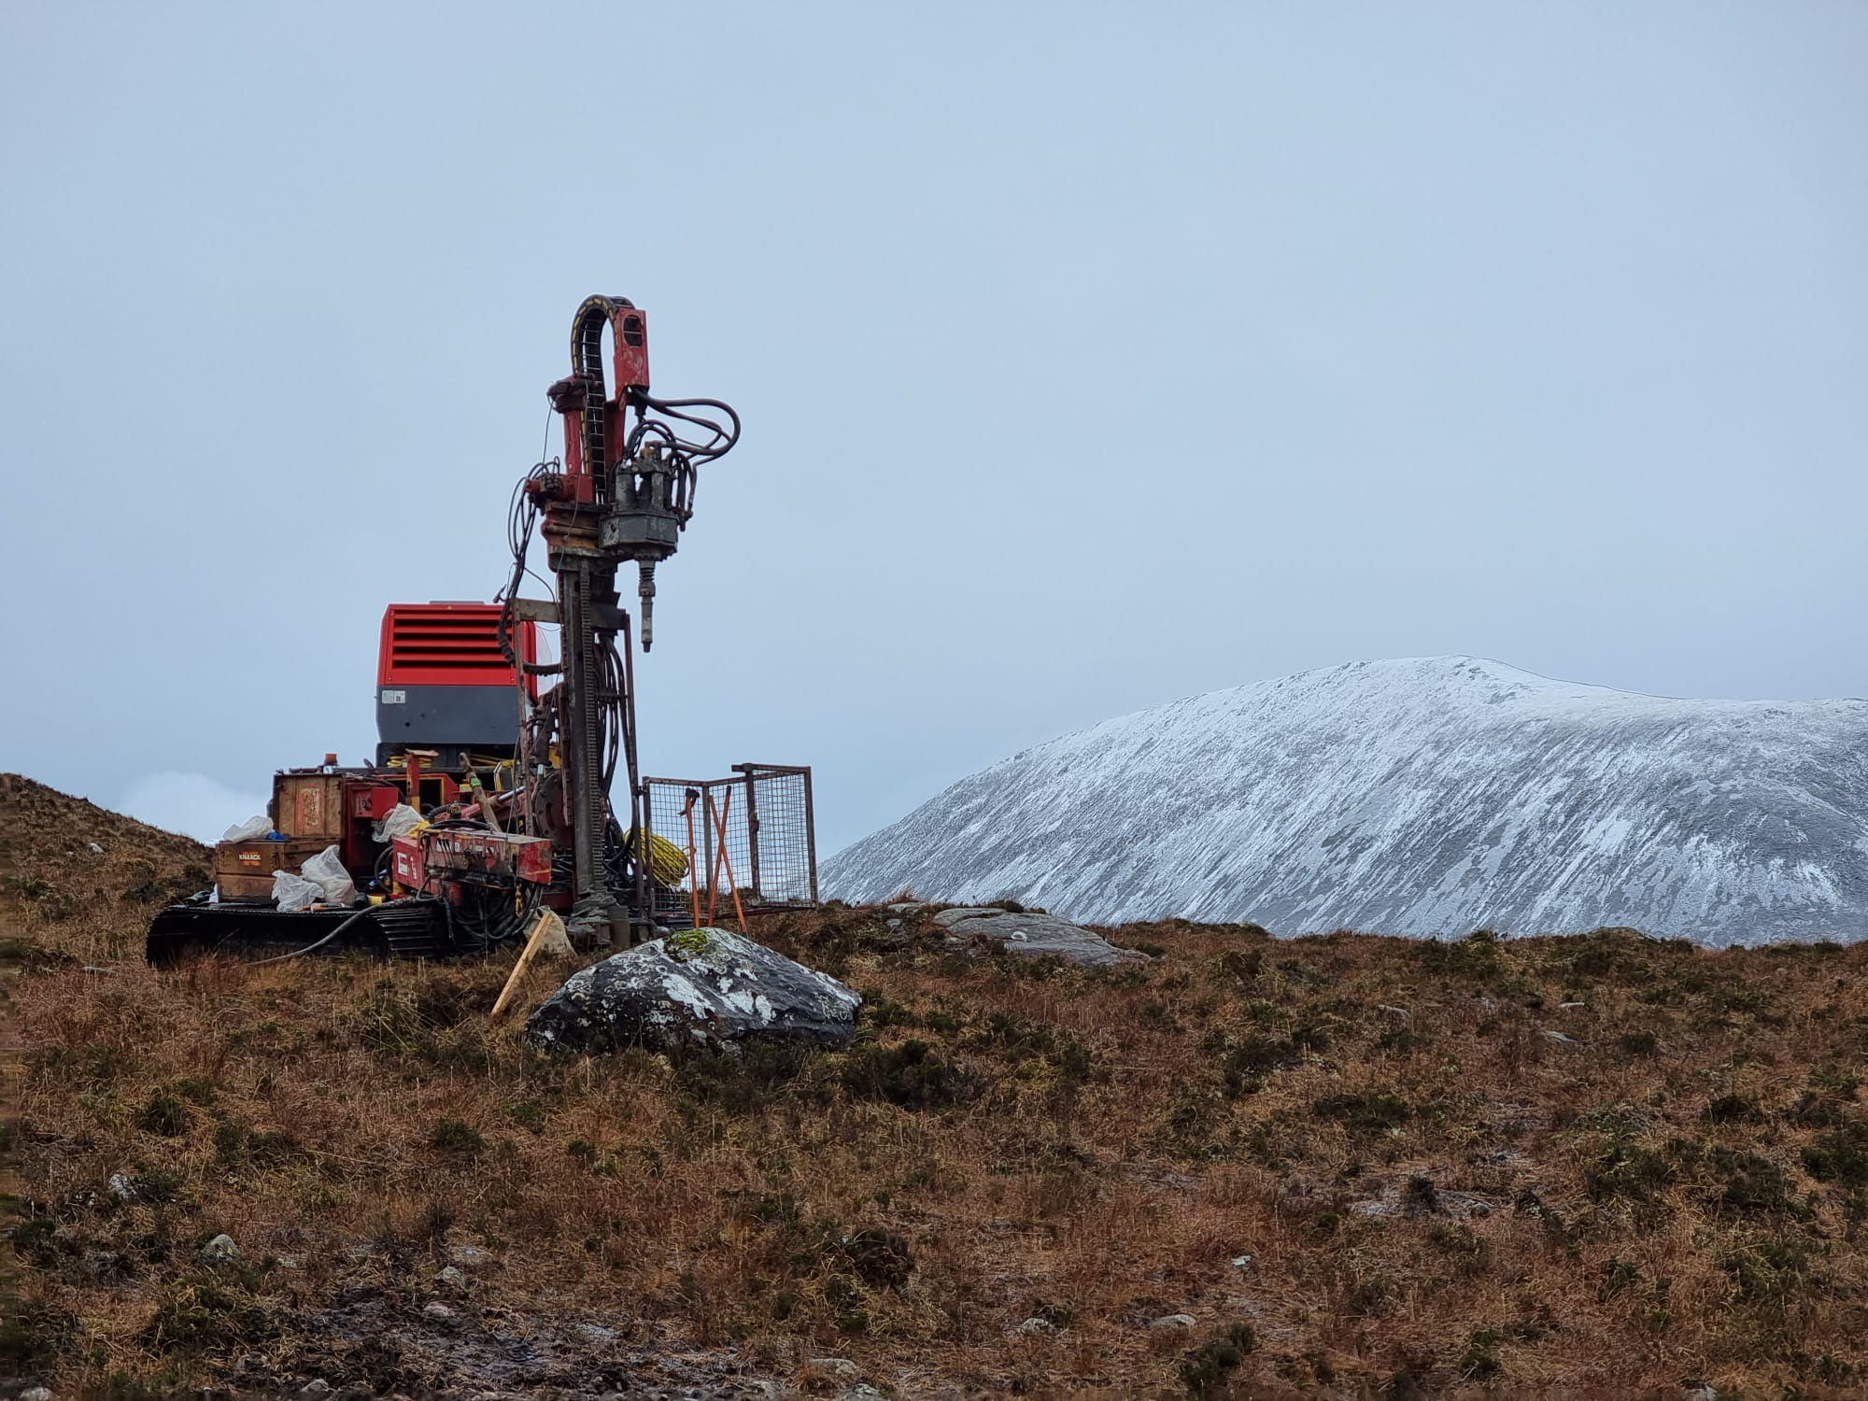
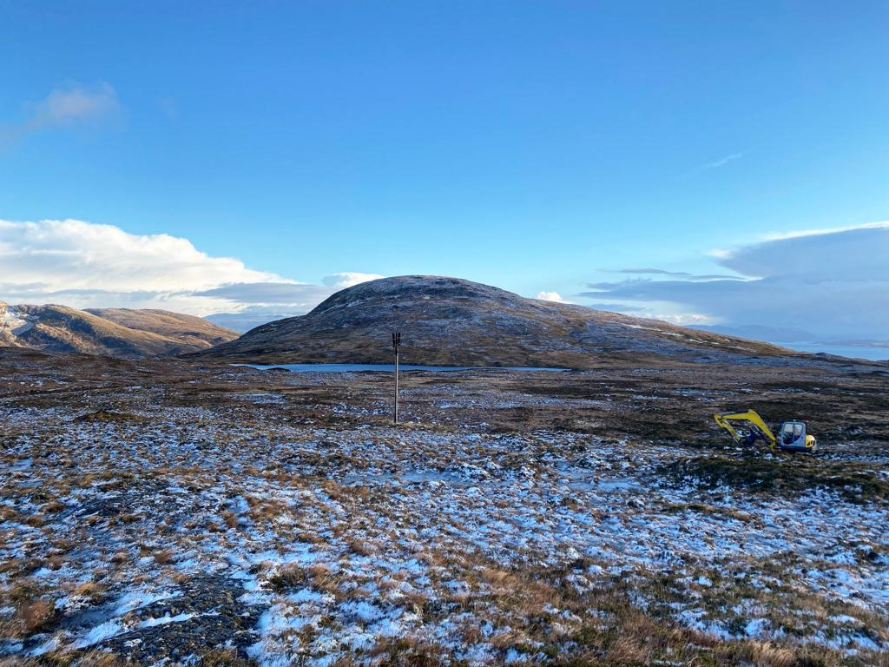
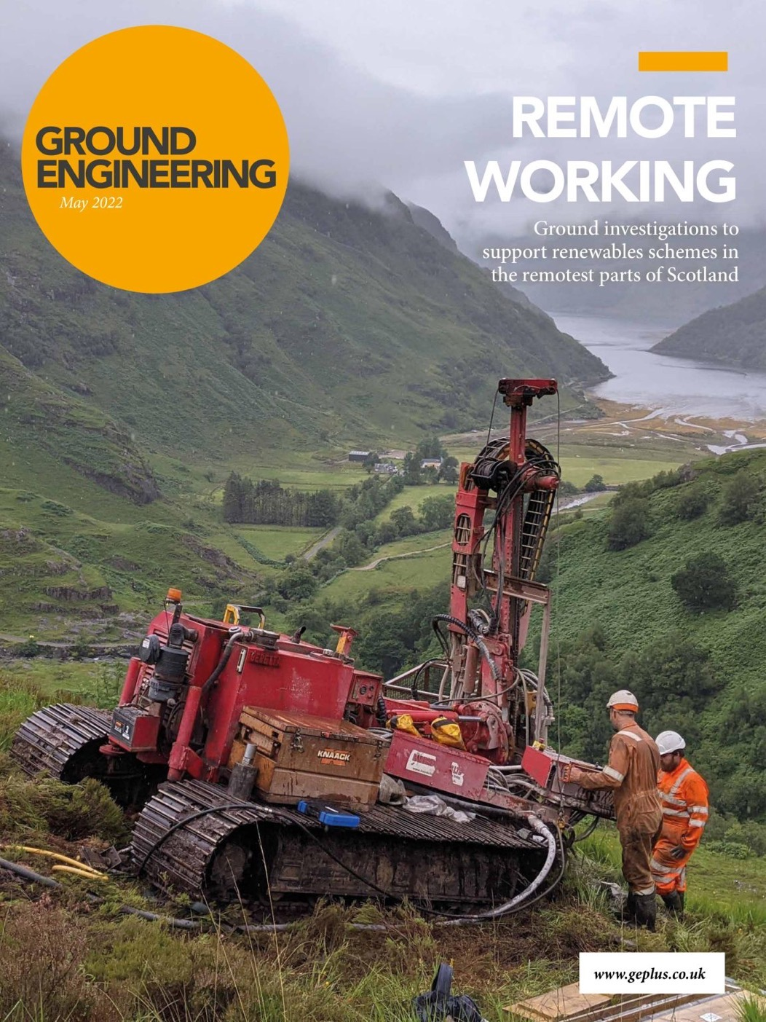
Case Study: Fort Augustus – Skye Overhead Line Reinforcement
To facilitate the recent advancement in renewable energy generation across Scotland, increase load capacity and replace an existing overhead line (OHL) in disrepair, a new OHL is proposed to be constructed between the Isle of Skye and Fort Augustus. The line will run from Edinbane Substation in the north to Auchterawe Substation in the south.
Bainbridge Brothers Limited (BBL) were appointed by Card Geotechnics Limited (CGL) for the main contractor Morgan Sindall Infrastructure (MS) on behalf of their end client Scottish and Southern Electricity Networks (SSEN) to complete the drilling and trial pitting aspects of the project. In total 435 borehole and 457 trial pit locations were undertaken. The boreholes were drilled using combined percussive and rotary drilling techniques. Groundwater monitoring standpipes were installed at selected tower locations.
Due to the extensively remote locations of each overhead line tower and subsequent borehole location, four ultra-widespread drilling rigs and support tracked compressor units were utilised, along with four low ground pressure excavators fitted with purpose built winches.
Various All Terrain Vehicles (ATVs) were used, depending on what ground conditions were to be travelled over and for what distance. Furthermore, the right machine was chosen to cause the least ground disturbance.
BBL brought their vast experience of completing site investigations in remote and challenging ground conditions to this project where every surface ground condition possible was found from rugged mountain boulder fields to very deep peat to deforested ‘brash mats’. The borehole locations reached heights of up to 500m above sea level. Our teamwork, dedication to get to the most challenging of positions and ‘can do attitude’ ensured that the site works ran smoothly.
More information on the project can be found at:
https://www.geplus.co.uk/features/renewable-energy-investigating-scotlands-trickiest-terrain-10-02-2022/
https://www.ssen-transmission.co.uk/projects/project-map/skye-reinforcement/

