Slide 1
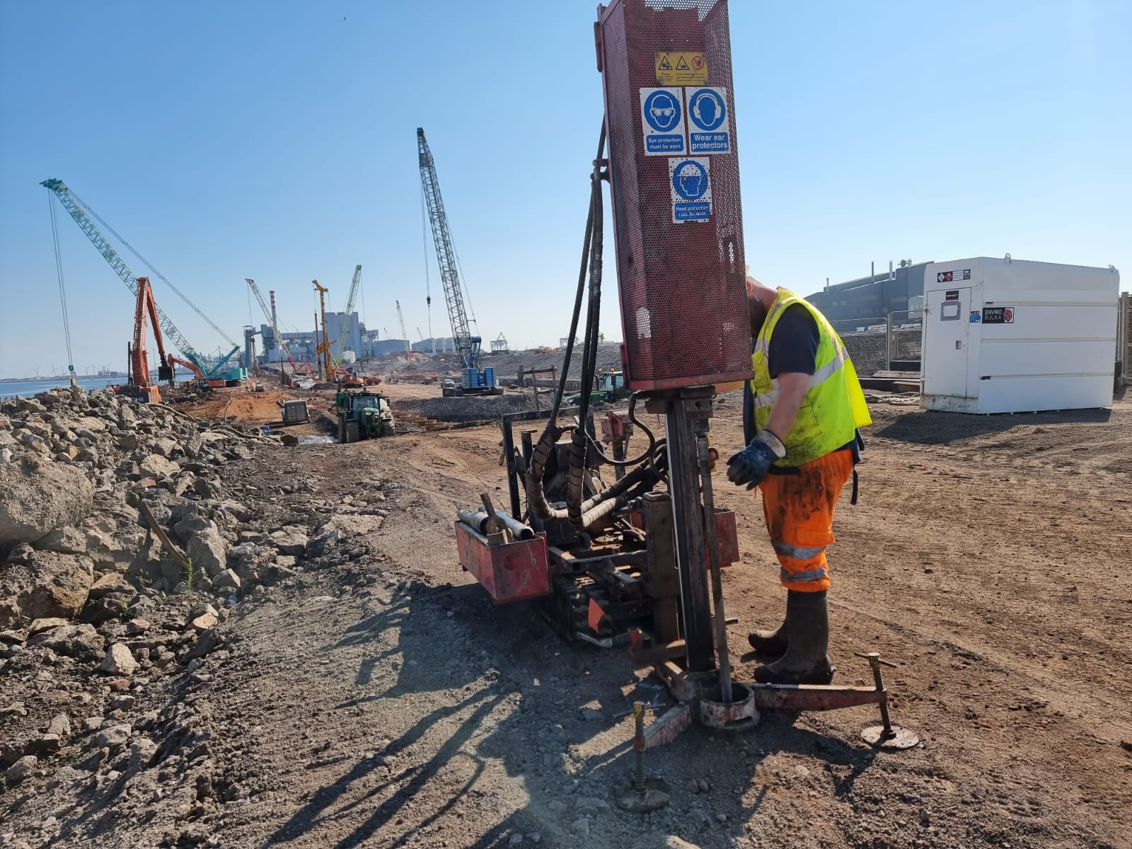
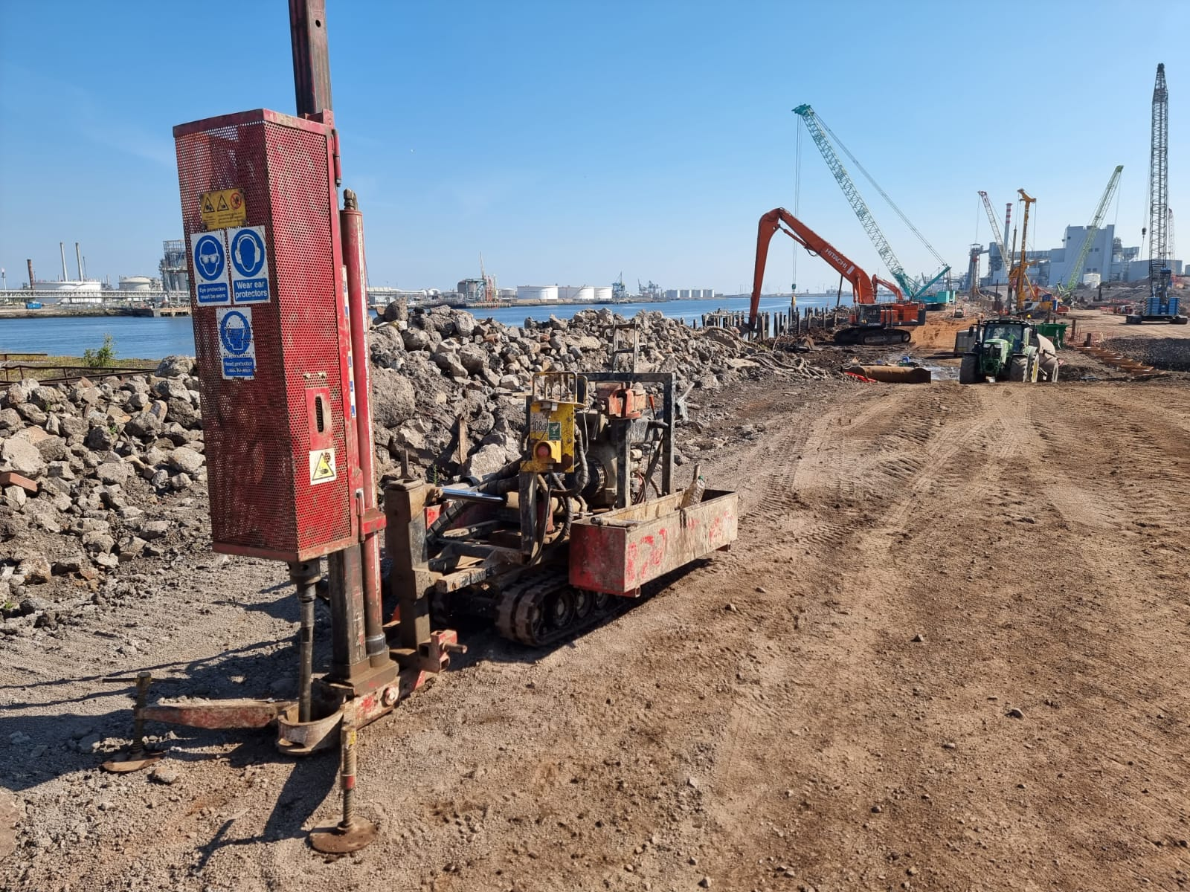
Rig Type / Model: | Window Sample - Archway Competitor Heavy Duty Dart
Transportation to Site: | Standard 3.5t van
Transportation around Site: | Own tracks
Hydraulic Cylinder Pullback: | 7000kg
Drop Weight: | 50kg or 63.5kg
Maximum Sample Diameter: | 150mm
Maximum Sample Depth: | 15m in favourable conditions
Weight: | 1070kg
Dimensions (LxWxH): | 2600 x 1080 x 1450mm in transport mode
 | 2950 x 1080 x 3100mm in sampling mode
Average Noise: | 71.4 - 74.3 dBA
Peak Noise During Sampling: | 94 dBA
Sampling / Testing Type | Window or windowless, SPT, U70 & dynamic probing
Engine: | Diesel 435cc single cylinder 9 HP
Used for: | Form shallow boreholes within superficial deposits by driving cylindrical steel tubes into the ground using a hydraulic hammer

